Slide 1
Open-End Services
Wednesday, February 8, 2017
Facilities Management

Slide 2
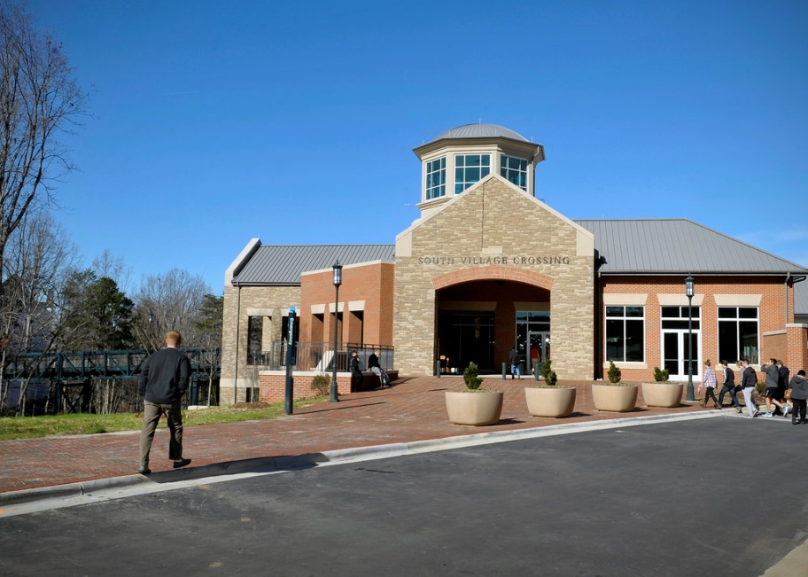
Agenda
Welcome – John A. Fessler, PE, Director
The Process – SF 330
The Past
The Schedule (contract FY)
The Chairs
The Project Managers
Questions

Slide 3
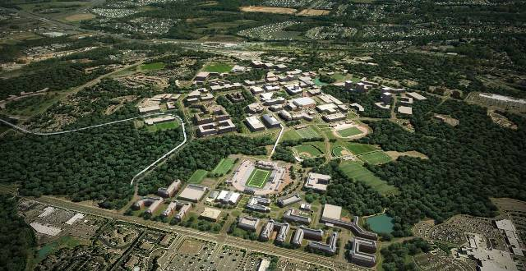
The Process
Overview (John A. Fessler, Director, Capital Projects)
Advertise, Review, Recommend, Select, Notify
SF 330—Be specific, limited 30 pages
Qualifications Based Selection (QBS)
General Statute 143-64.31

Slide 4
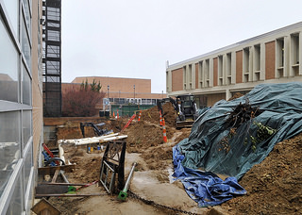
The Process SF 330
Follow directions
Number of copies
Page length
CD (one file pdf file please)
Winners
Proven experience in category (the team)
Local
New faces

Slide 5
The Process QBS
Our Team
PE / AIA Chair
Project Managers (two)
Your Team (workers not overhead)
Appropriate expertise
Past performance
Proximity to campus
Familiarity to local area
Adequate staffing levels

Slide 6
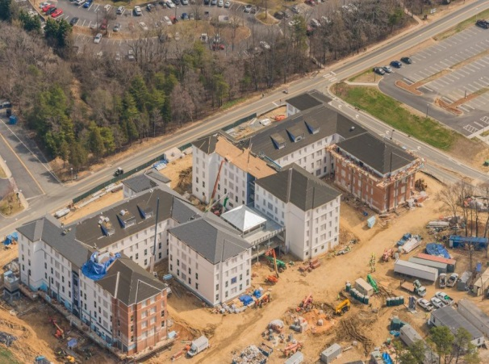
The Past
2015/16—Fee total ($282,267)
Architecture--$69,261 (20 received, picked 4)
Civil Engineering--$94,646 (22 received, picked 5)
Constr. Services--$22,520 (12 received, picked 3)
MEP--$95,840 (10 received, picked 3)
Surveying--$0 (5 received, picked 2)
Commissioning--$0 (6 received, picked 2)

Slide 7
The Past
2014/15—Fee total ($809,469)
Architecture--$349,027 (31 received, picked 7)
Civil Engineering--$244,616 (25 received, picked 3)
Constr. Services--$80,781 (13 received, picked 4)
MEP--$126,370 (15 received, picked 4)
Surveying--$8,675 (13 received, picked 3)
Commissioning--$0 (8 received, picked 1)

Slide 8
The Past
2013/14—Fee total ($824,624)
Architecture--$321,447 (27 received, picked 8)
Civil Engineering--$227,417 (30 received, picked 6)
Constr. Services--$80,770 (18 received, picked 3)
MEP--$194,990 (22 received, picked 4)
Surveying--$0 (11 received, picked 4)
Commissioning--$0 (12 received, picked 2)

Slide 9
The Past
2015/16—Fee total $282,267 (6 categories)
2014/15—Fee total $809,469 (6 categories)
2013/14—Fee total $824,624 (6 categories)
2012—Fee total $1,006,051 (7 categories)
2011—Fee total $553,225 (7 categories)
2010—Fee total $1,119,168 (7 categories)
2009—Fee total $500,835 (7 categories)

Slide 10
The Schedule
Jan 18 Post Advertisement
Feb 8 Mandatory Pre-proposal meeting
Feb 22 SF 330 due
Feb 28 Committee Chairs meet
Mar 28 Committee recommendations
April 3 Recommendations reviewed by senior staff
April Board of Trustees approval
May Notification to firms

Slide 11
The Chairs
Architecture—Chris Gilbert, AIA
Civil Engineer/Site—John Fessler, PE
Commissioning—Tom Sparks, PE
Construction Services—Jennifer Price, PE
MEP—Tony Schallert, PE
Surveying—Jeanine Bachtel, PE

Slide 12
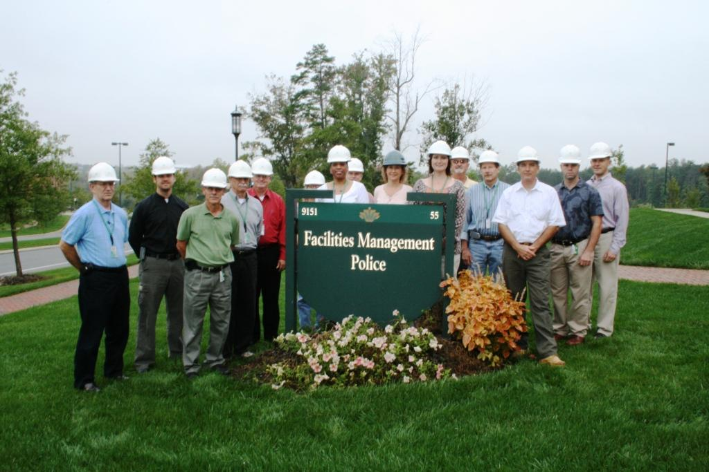
Project Managers
Design Services
Mac Fake, John Boal, Steve Terry, David Love
Amanda Caudle
Architectural Planning
Chris Gilbert, Nick Patel
Capital Projects
John Fessler, Jeanine Bachtel, Lisa Lanier, Brian Kugler,
Elizabeth Frere, Donia Schauble, Tom Sparks,
David Daignault, Tony Schallert, Peter Franz

Slide 13
Questions
Civil Engineering/Site—provide all services?
Should each submittal include all sub-services listed
in parentheses?
If we could not provide all services in-house, should
we compile a team to cover all?
Teaming due firm’s services—if needed
Cover sheet does not count to 30 page limit

