Slide 1
UNC Charlotte
Health & Wellness Center
Pre-Submittal Conference
June 9, 2015, 2:00 PM
Cone Center - Room 210

Slide 2
Meeting Agenda
PART I - General
PART II - Submittal
Welcome
Introductions
Questions:
dschauble@uncc.edu
Updates:
facilities.uncc.edu/advertisements
Last date to submit questions June 12. A final addendum will be posted no later than June 16.
HUB and Small Business Enterprise are not considerations for designer selection
Schedule
Submittal Format
Selection Criteria
PART III - Project
Budget
Project Size
General Project Information
Program
Key Challenges & Vision
Site
Designer Questions
Optional Site Visit

Slide 3
Submittal
Submittal Schedule
Proposal Due Date June 23rd at 2:00 PM
Shortlisting to be completed in mid-July
Interviews for selected firms will be in the morning of July 29, 2015
Projected Notice to Proceed Date Sep. 1st, 2015
Projecting AP completion in December 2015
Note: This is an Advance Planning Submittal with option to retain firm for full design services.

Slide 4
Submittal
Submittal Format
No larger than 12 ½” in height x 9 ½” in width
Provide 5 printed copies & 1 digital copy
50 page limit (25 double sided)
Page limit incudes all printed pages, but not covers, tabs, clear covers, blank pages, cardstock backs, etc.
Page count will be derived from digital copy, so omit all blank pages from the digital version

Slide 5
Submittal Organization
Provide Information in the following Order:
  Required Submittal Cover Sheet
  Designer’s Supplemental Information Form (or Designer’s Staffing Information Form)
  Cover letter (optional)
  SF330 Part I & II (Make sure to fully complete and submit both parts!)
      Note: please list square foot cost for projects shown in bold print!
  Supplemental Information organized into 10 categories with subheadings matching the 10 Designer Selection Criteria

Slide 6
Selection Criteria
Submittals must clearly provide information for each category below utilizing the numbering system and categories for the submittal subtitles.
(1) Specialized or appropriate expertise in this type of project.
(2) Past performance on similar projects, preferably recreation facilities.
(3) Adequate staff and proposed design or consultant team for the project.
(4) Current workload and State projects awarded.
(5) Proposed design approach for the project including design team and consultants.
(6) Recent experience with project costs and schedules.
(7) Construction administration capabilities.
(8) Proximity to and familiarity with the area where project is located.
(9) Record of successfully completed projects without major legal or technical problems.
(10) Other factors that may be appropriate for the project. For example experience with confined sites, 4+ story recreation facilities, phased design & construction of recreation facilities, etc.

Slide 7
LESS IS MORE

Slide 8
Project Overview
Project Budget
AP Project Authorization - $6.6M
Total Project - $60M incl. soft costs (this does include the AP Authorization of $6.6M)
Construction Cost - $45-50M
Project Size
160,000 GSF
Potentially up to 4 Stories (including partial basement, due to sloped site)

Slide 9
General Project Information
The Health & Wellness Center has been conceived as a 3 Phase Project, including Phase IA, Phase IB, and Phase II.
The current Project will provide only Phase IA of the conceived program.
However, since our site is confined and the total project square footage for all 3 Phases includes almost 285,000 square feet, the Advance Planning for the project will encompass a phased concept including plans, elevations and 3D renderings for all 3 Phases to ensure that the final project can be successfully provided on the selected site.

Slide 10
Project Program for Phase IA
Main Entrance Lobby with Reception and Entrance Control
General Administration Offices
Gymnasium Space (3 to 4 Courts) with Suspended Walking/Running Track
  Consideration for one or two Courts to be Multi-Purpose Activity Courts (MAC) for indoor Hockey, Soccer, etc.
Fitness Space including: Cardio, Selectorized & Free Weights, Functional Training Area
Multipurpose / Group Fitness Spaces for various instructional-based activities such as Spinning, Kickboxing, Pilates, Yoga, Zumba, etc.

Slide 11
Locker Rooms including: Showers, Changing Rooms, Restrooms, Vanity Areas, Special Needs Accommodations and ADA compliance
Natatorium including: Lap Pool and Recreational Pool (could be accommodated with a single multi-functional pool with separate areas for both functions)
Nutrition Program Space
Support Spaces including: Equipment Checkout, Small Meeting Rooms, Laundry, Storage, Fitness Maintenance Room, General Building Maintenance and Service Spaces, Staff Break Rooms, etc.
Core & Circulation

Slide 12
Project Program for Phase IB
Natatorium Space for Athletics to include:
  50 Meter Competition Pool (possibly with movable bulkhead)
  Spectator Seating for 200-500 people
  Wet Classrooms
  Storage
Meet Control Room
Team Locker Rooms & Lounge/Meeting Room
Dry Land Training Room
Coaches Offices
Additional Core & Circulation

Slide 13
Project Program for Phase II
University’s existing Outdoor Recreation Center (Venture) including Reception, offices, Trip Planning Room, Equipment Checkout & Storage, Equipment Wash & Maintenance Space, Trip Prep Area, Loading Area etc.
A second Gymnasium (3 to 4 Courts) with storage
Combined Racquetball/Squash Courts
Indoor Climbing Wall
Outdoor Pool and Deck & Support Building
Additional Core & Circulation

Slide 14
Programing Consultant
The University consulted with Brailsford & Dunlavey to provide the current building program.
Brailsford & Dunlavey will be retained directly by the university as a project program consultant throughout Advance Planning and beyond if needed.
Design Firms submitting proposals will not need to contract out or provide program services.

Slide 15
Key Project Challenges
110,000 square foot site will have to accommodate a 285,000 square foot building program.
Appropriate multi-story programming allowing for good flow of all program activities.
Careful consideration of best use for each floor considering highest public interaction, flow of entrance and exit travel, appropriateness of space adjacencies, etc.
Imaginative phasing plan, allowing for both a great final solution as well as an initial phase with an attractive and complete appearance (the building shouldn’t look like it’s waiting for an addition)

Slide 16
Recreation Department’s Vision
Understated but welcoming casual feel
The first impression of the building and the main lobby should not present overwhelming to first time visitors
Building should be laid out efficiently without wasted space
Student waiting and gathering areas should be found throughout the facility in all activity spaces (a large lounge space is not desired)
The entire facility should feel open, comfortable, and un-crowded

Slide 17
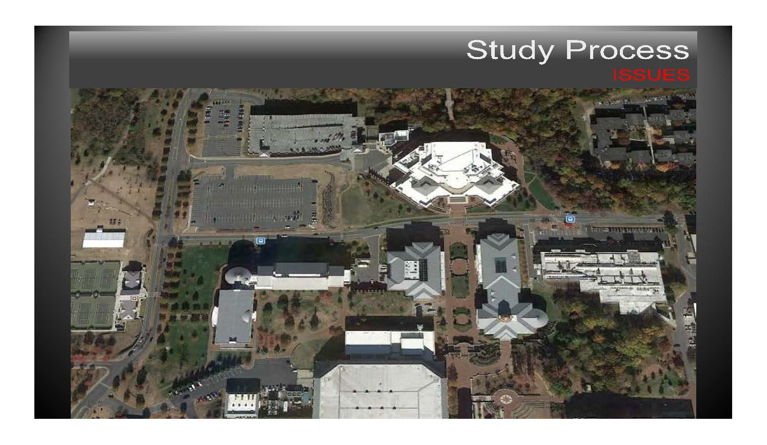
Project Site
+/- 110,000 square foot site

Slide 18
Approximate Building Location
+/- 70,000 sq.ft. potential building footprint

Slide 19
QUESTIONS ?

Slide 20
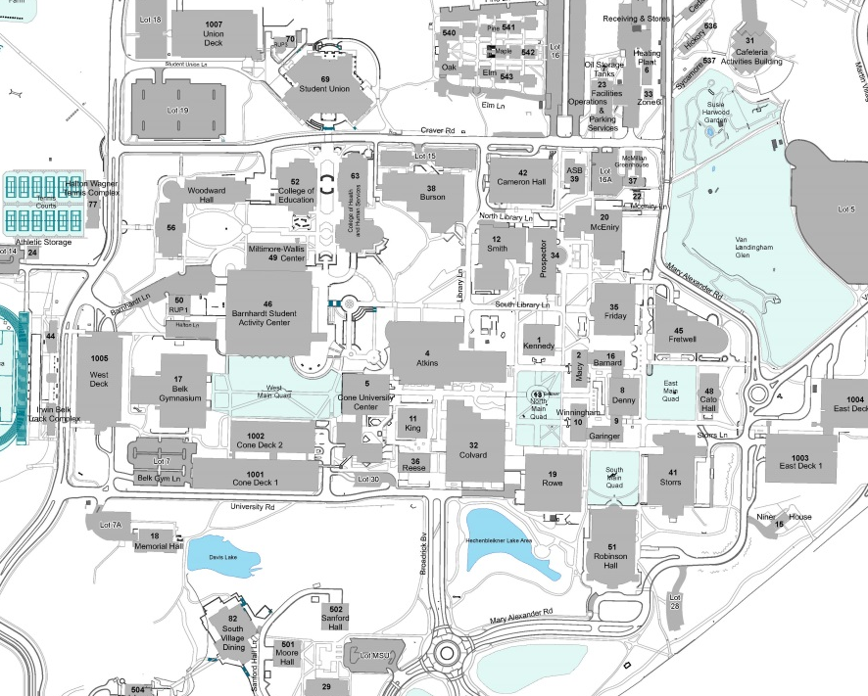
Map

